Slide 1

Fake news detection problem
By - JAY PANDEY
Internship Batch No- 32

Slide 2

Introduction
Fake news's simple meaning is to incorporate information that leads people to the wrong path. Nowadays fake news spreading like water and people share this information without verifying it. This is often done to further or impose certain ideas and is often achieved with political agendas.
For media outlets, the ability to attract viewers to their websites is necessary to generate online advertising revenue. So it is necessary to detect fake news.

Slide 3
Problem Statement
Fake news has become one of the biggest problems of our age. It has serious impact on our online as well as offline discourse. One can even go as far as saying that, to date, fake news poses a clear and present danger to western democracy and stability of the society.

Slide 4
Data Sources and their formats
Fake dataset - 23481 rows and 5 columns.
True dataset - 21417 rows and 5 columns.
Our target feature is to analyse the news.
Most of the features are categorical.

Slide 5
Data Pre-processing
No, Null value is present.
Removing last 10 rows from both the dataset, for manual testing.
Merging the manual testing dataframe in single dataset and save it in a csv file.
"title", "subject" and "date" columns is not required for detecting the fake news, so I am going to drop the columns.

Slide 6
Exploratory Data Analysis
As we do not have multiple columns and value to perform the EDA. Therefore not performing many EDA anlysis.
Checked only NULL values, duplicated entires, blank row and coloums.
There is no NULL values present in dataset.

Slide 7
Machine Learning - Model Building

Slide 8
Natural Language Processing
Machine learning data only works with numerical features so we have to convert text data into numerical columns. So we have to preprocess the text and that is called natural language processing.
In-text preprocess we are cleaning our text by steaming, lemmatization, remove stopwords, remove special symbols and numbers, etc. After cleaning the data we have to feed this text data into a vectorizer which will convert this text data into numerical features.
Analysing the dataframe with help of natural language processing:
Classified the ‘fake news’ with 0 and ‘ture news’ with 1.
Removing last 10 rows from both the dataset, for manual testing.
Merging the manual testing dataframe in single dataset.
Merging the main fake and true dataframe.

Slide 9
Machine Learning Algorithm Used
The different regression algorithm used in this project to build ML model are as below:
Linear Regression
Decision Tree Classification
Gradient Boosting Classifier
Random Forest Classifier

Slide 10
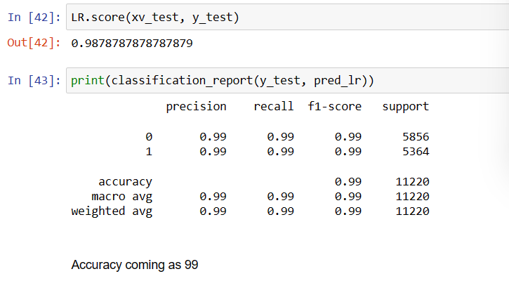
Linear Regression
Below is the Accuracy report

Slide 11
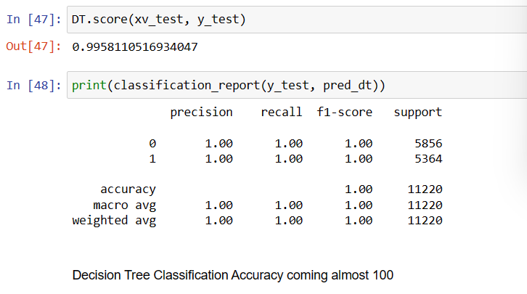
Decision Tree Classification

Slide 12
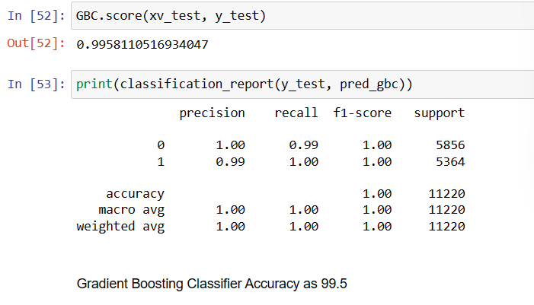
Gradient Boosting Classifier

Slide 13
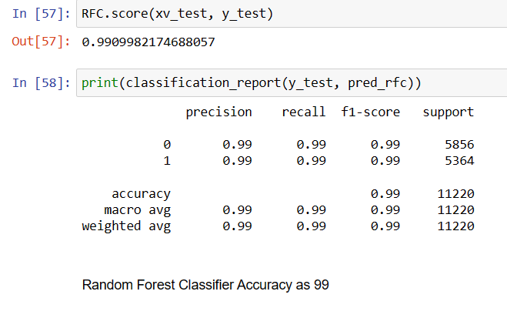
Random Forest Classifier

Slide 14
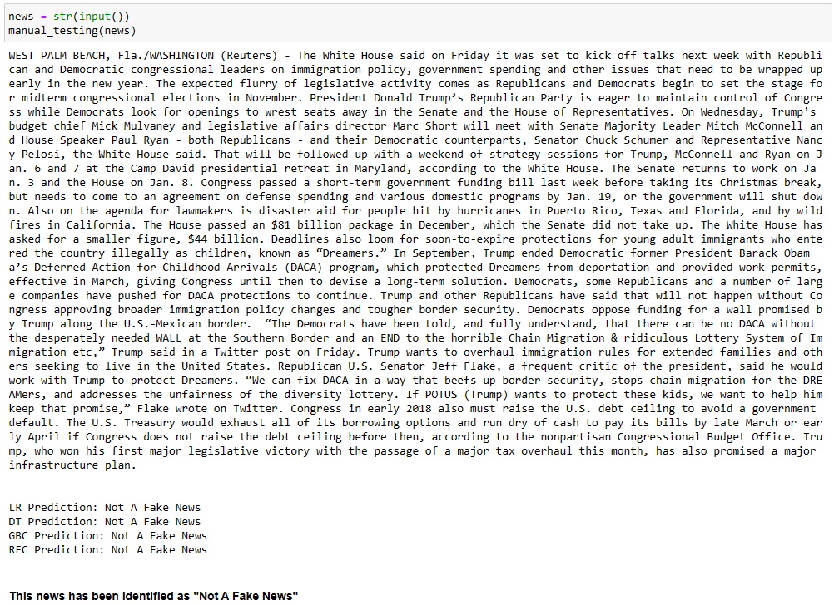
Model Testing With Manual Entry
We have done two manual testing and result are below:

Slide 15
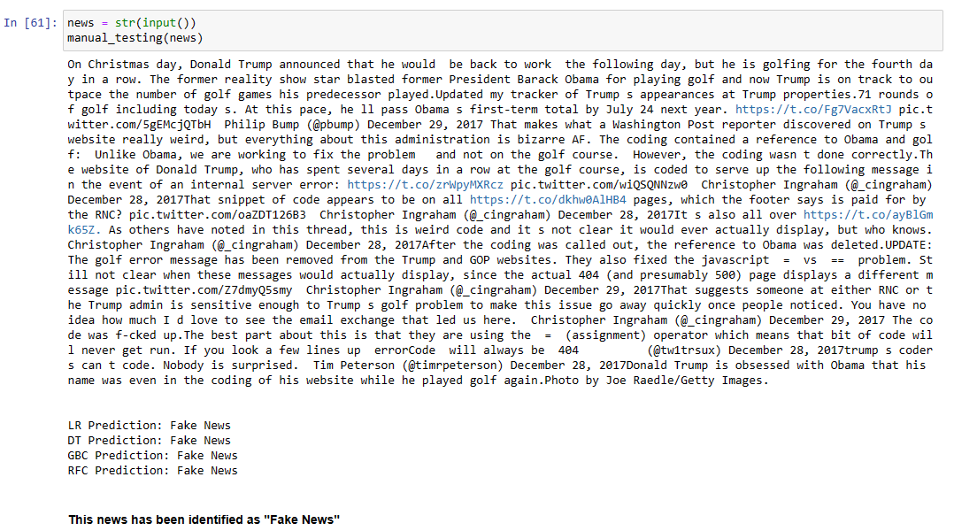
Cont.

Slide 16
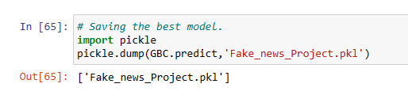
Saving the Model
Saving the model with pickle method for future reference.

Slide 17


